Slide 1
ONLINE FOOD Order Analysis
Presented By:
Keerthana Buddhavarapu -CSE
Vignan ’s Institute of Management and Technology for Women

Slide 2
OUTLINE
Problem Statement
Proposed System/Solution
System Development Approach
Result
Conclusion
Future Scope
References

Slide 3
Problem Statement
An Online Food order platform facilitates ordering food from various restaurants via websites or apps, providing convenience and a wide range of dining options to users.
Its influence extends to reshaping consumer dining habits and driving digital transformation in the food service industry.
The problem statement revolves around analyzing ,to optimize the efficiency and profitability of online food ordering platforms. There is a critical need to analyze consumer behavior, market trends, operational challenges, and technological impacts, in order to enhance user experience, streamline logistics, and maximize revenue for both restaurants and delivery services.

Slide 4
Proposed Solution
The proposed system aims to address the challenge of understanding the required Online Food Orders and their relationships with various attributes . This involves leveraging data analytics to understand demand patterns accurately. The solution will consist of the following components:
Data Collection:
The dataset contains information collected from an online food ordering platform over a period of time. It encompasses various attributes related to Occupation, Family Size, Feedback etc…
Data Preprocessing (Cleaning and Preparation):
Data preprocessing for online food order analysis involves cleaning for missing values and duplicates, and transforming categorical variables into numerical formats like one- encoding for cuisine types and payment methods.
Prepare the data for analysis by structuring it in a suitable format.
Data Analysis:
Utilize statistical methods and techniques to uncover patterns such as popular food choices, peak ordering times, and customer behavior analysis. Explore the data to understand patterns, trends etc. This might include visualizations, statistical summaries, and segmentation analysis.
Evaluation:
Assess the effectiveness of implemented strategies or models using performance metrics (e.g., accuracy, precision, recall).
Evaluation ensures the reliability and relevance of insights derived from the data analysis phase. It supports continuous improvement and validation of decision-making processes, guiding future actions and investments in the online food ordering platform.

Slide 5
System Approach
In the context of analysis, a system approach refers to a structured and holistic methodology for studying and understanding complex phenomena or problems. It involves breaking down the subject into its constituent parts, examining their interrelationships, and analyzing how these parts function together as a unified whole.Here's a suggested structure for this section:
System requirements : Windows OS, I3Processor
Library Required to Build the Model: IBM Watson Studio
INPUT: The dataset contains information collected from an online food ordering platform over a period of time. It encompasses various attributes related to Occupation, Family Size, Age, Monthly income, Latitude, Longitude, gender, Feedback, Output etc..
OUTPUT: The final output is a successful delivery of food to the customer and provide them with better experience by including factors like customer experience, order accuracy.
Feedback Loop: Implement a feedback mechanism to gather customer feedback and integrate it into the analysis process, ensuring ongoing improvement and adaptation to changing customer needs and market trends.

Slide 6
Result
The dataset contains information collected from online food ordering platform over a period of time with various attributes like Occupation, Family Size, Age, Monthly income, Latitude, Longitude, gender, Feedback, Output etc..
To analyse online food orders, we have to consider metrices such as:
Feedback of Customers
Areas or places with more orders.
By analysing these metrices, we can gain insights into customer behaviour, preferences, and areas for improvement in the online food ordering services.

Slide 7
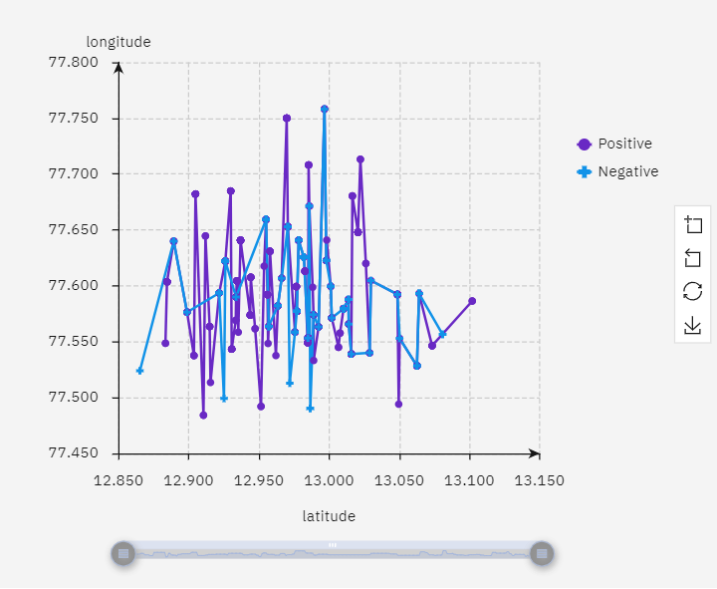
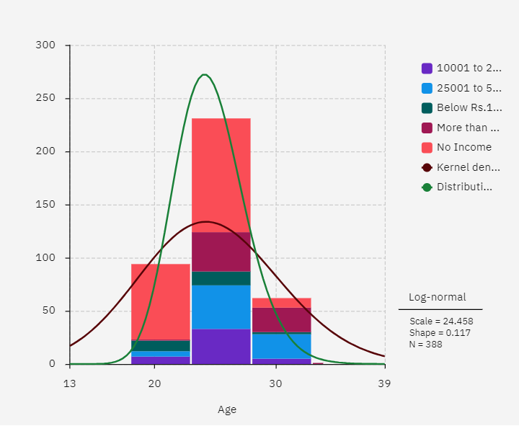

Slide 8
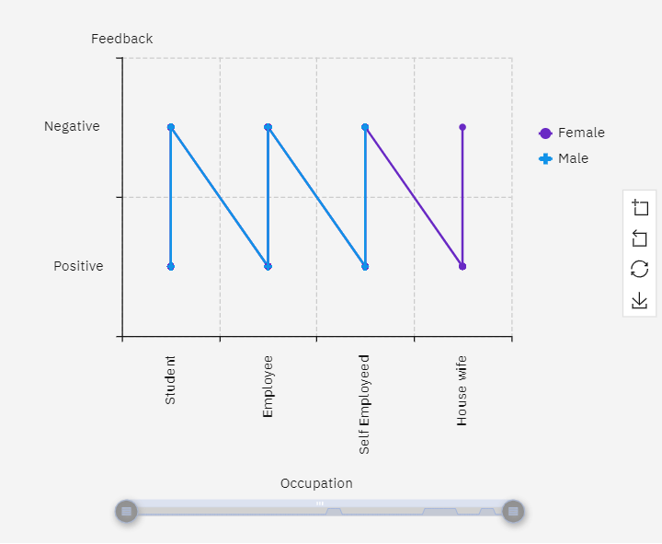
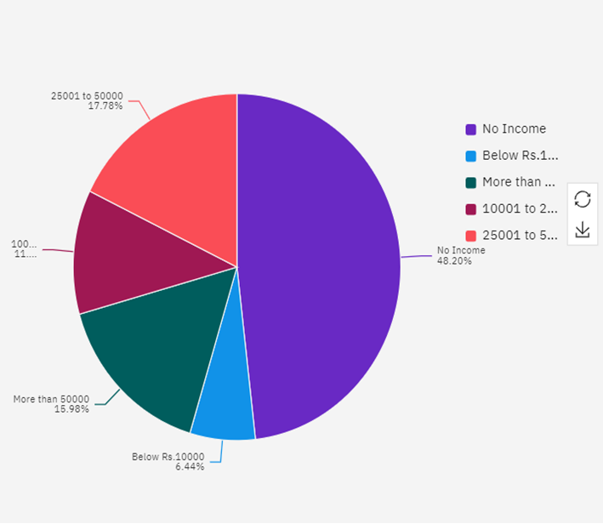

Slide 9
Conclusion
After analyzing the data on Online Food Orders, it’s evident that there are several key insights and trends to consider.
Popular Items and Trends: Visualizations revealed the occupation and feedback, highlighting trends in customer preferences.
Order Distribution: Line graph and charts illustrated where orders originated, aiding in targeted marketing and operational planning.
The analysis of online food orders highlighted valuable insights into customer behavior and . By leveraging data visualization and analytics, the project not only optimized business operations but also enhanced customer satisfaction and loyalty.

Slide 10
Future scope
The future scope of online food order analysis holds several promising avenues for innovation and improvement:
Personalized Customer Experience: Implementing advanced analytics to personalize recommendations based on individual customer preferences, order history, and demographic data.
Predictive Analytics: Utilizing machine learning models to forecast demand, optimize inventory management, and predict customer behavior to minimize waste and enhance efficiency.
Real-Time Data Processing: Enhancing capabilities for real-time data processing to improve order processing times, delivery tracking, and responsiveness to customer queries.

Slide 11
References
Kaggle which is a subsidiary of Google, is an online community which allows users to find datasets they want to use to publish datasets and also work with various datasets. IBM cloud is used for overall visualization of the dataset and google collab for analyzing dataset.

Slide 12
THANK YOU

